Slide 1
Comparison of GATK HaplotypeCaller
and Freebayes Variant Calling tools
ETF Belgrade
Petar Jokic 2020/3343
Milan Babic 2019/3441
Notes:
Welcome. This is presentation of project done as part of Genomic Informatics course on master studies at Electrical Engineering faculty on Belgrade University. My name is Milan Babic and together with my colleague Petar Jokic we will present you our work.

Slide 2
Agenda
Task
Variant Calling
Tools
GATK
Freebayes
Generated VCF files
Manual calculation of metrics
Comparison of metrics calculated by different tools
Graphs
Conclusion
Notes:
This is today’s agenda. First we will see what was objective of our project. After that we will see some basic information regarding tools and methods we used and then we will go through our work see what is our end result.

Slide 3
Project
Preform Variant Calling on C835.HCC1143.2.converted.realigned.base_recalibrated.bam file and use human_g1k_v37_decoy.fasta as reference genome by using GATK 4 HaplotypeCaller and FreeBayes Variant Calling tools.
Compare results given by those two tools. Take that HaplotypeCaller is truth set and Freebayes is test set, and then make detail report in form of diagram how many variants are matched (True positives) , how many of them exist in test set but doesn’t exist in truth test (False positives), and also how many of them exist in truth set but doesn’t exist in test set (False negatives). Calculate precision recall and F-score metrics. To achieve this use manually written script or tools from internet.
Notes:
Objective of our project was to perform Variant calling on provided BAM file and using human genome as reference genome (fasta file) by using GATK 4 Haplotype Caller and Free Bayes variant calling tools. 2nd tasks was to compare output files from previous step taking Halpotype Caller as truth set and Freebayes as test set and getting out various metrics from that comparison like True positives, False positivises, False negatives and also calculate precision recall and F-score metrics.

Slide 4
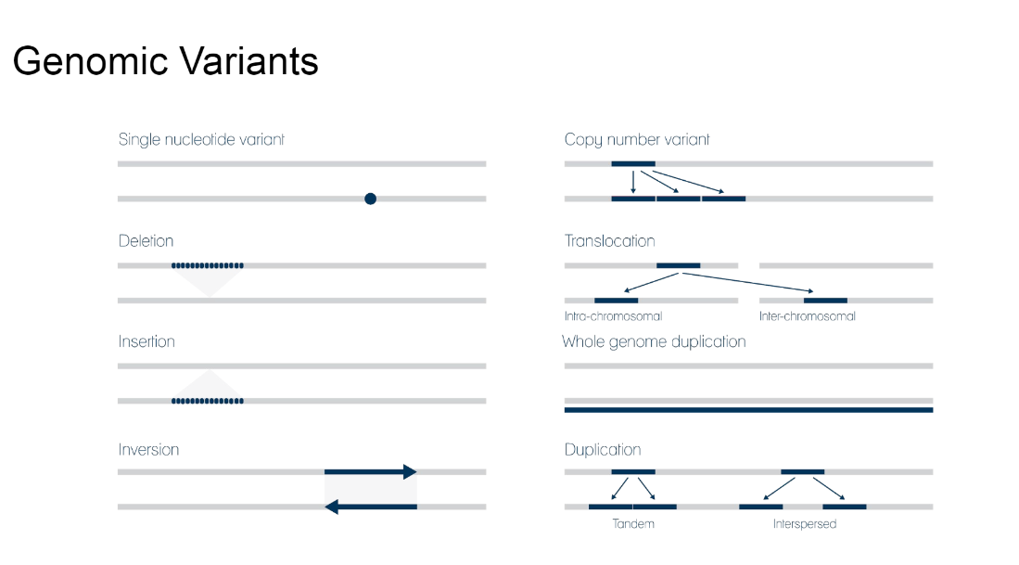
Variant calling
What is variant calling?
Variant calling is the process of finding differences between reference genome and observed sample
There are number of different genomic variants
SNV – Single nucleotide variant
Notes:
Before we start with our project, let’s first go through some basics we needed for this project.
Variant calling is the process of finding differences between reference genome and observed sample
Variant Calling is usually final phase of DNA analysis
There are number of different genomic variants
Single nucleotide variant
Deletion
Insertion
Inversion
Copy number variant
Translocation
Whole genome duplication
Duplication (tandem or interspersed)
Different genomic variants can have different impact on human cells and organism
SNV – Single nucleotide variant (simple alternation of single nucleotide but it can cause phenotype
Based on variant location we can predict if mutation will have impact

Slide 5
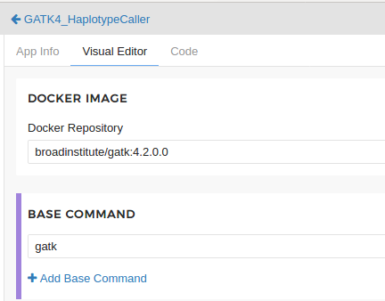
Tools – GATK 4 HaplotypeCaller
Very large tool
Docker image
Created SBG App
RUN Command
Notes:
Now lets talk about tools we used. First tool is GATK 4. GATK 4 is very large tool and it is able to preform many different tasks. In our solution we use only small subset of it which name is, as you can guess HaplotypeCaller.
Prerequisite for using this tool is to have installed java-jdk and corresponding python and R libraries, but fortunately there is more convenient way to achieve this by using official Docker image, so this was our choice. We also used Seven Bridges platform in order to make app for our task. It is worth to note that there already was existing GTAK app on platform but it has much earlier release date and it is deprecated for our needs.
At the bottom of the slide we can we see command for running tool.-R switch is reference file and I switch is for input BAM file, with -O switch we determinate name of our input file which is compressed VCF, so we will need to unzip it.

Slide 6
Tools – Freebayes
pre-built 64-bit static Linux binary
RUN Command
Notes:
Second tool we used is Freebayes.
Frebayes is much smaller tool compare to GTAK and is specialized for finding small polymorphismsand best thing is that it comes with pre built x64 bit linux library, so we don't need to install anything.
Again, here we can see RUN command with -f switch we state needed files and after grater mark we put name of output file. var.vcf in this case.

Slide 7
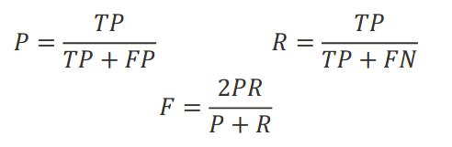
Generated VCF files
File generated by GATK (output.vcf) is truth set.
File generated by Freebayes (var.vcf) is test set.
True positives: Predictions (mutations) which exist in both truth and set VCF file.
False positives: Predictions that exist only in set file.
False negatives: Predictions that exist in truth but doesn’t exist in set file.
Precision, Recall and F-score formulas:
Notes:
Once we performed Variant Calling on provided BAM file using human_g1k_v37_decoy.fasta as refence genome and using both Tools (GATK and Freebayes) we geenrated two VCF files. VCF file is short of Variant Call Format and specifies format of text file for storing gene sequence variations.
Now we can use generated VCF files to calculate number of important metrics like True positives, false positives, false negatives as well as precisiong, recall and F-score.
True positives: Predictions (mutations) which exist in both truth and set VCF file.
False positives: Predictions that exist only in set file.
False negatives: Predictions that exist in truth but doesn’t exist in set file. Precision, Recall and F-score formulas.
Evaluating variant calls requires complex matching algorithms and standardized counting, because the same variant may be represented differently in truth and test callsets. High-confidence variant calls and regions that can be used as “truth” to accurately identify false positives and negatives are difficult to define, and reliable calls for the most challenging regions and variants remain out of reach.

Slide 8


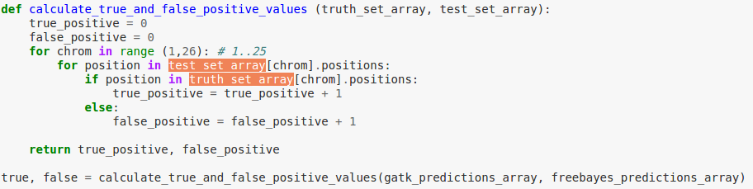

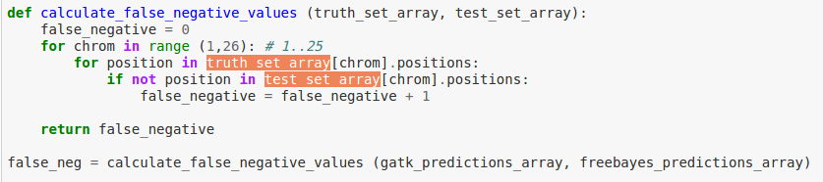
Manual calculation of metrics
Notes:
In order to calculate values of true positives and false negatives colleague Petar created manual script. We will then use these values to calculate precision, recall and F1 score metrics.
We calculate only number of SNPs. We used VariantFile from pysam library which has support for reading VCF records.
First we prepared data, we made two arrays which consist positions of mutations for each chromosome in VCF file, for truth and test set.
We go through each chromosome in set file and check do that position exist in corresponding chromosome in truth file. If it exist then we count it as True positive, otherwise if it doesn't exist then we count it as False positive.
On similar way we can count number of false negatives, but now we go through truth set again chromosome by chromosome and we are checking if position doesn't exist in set file. If that is true then we have false negative.
Results which we get are as we expected. Now by using previous formulars we can calculate metrics.

Slide 9
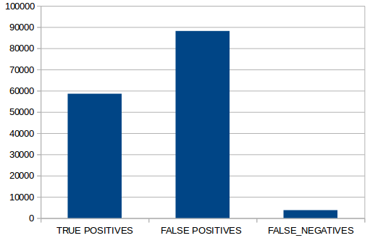
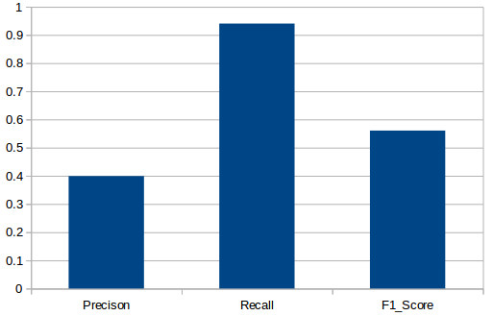
Graphs
Comparing VCF files is not easy task
Due to the complexity of the human genome, performance can vary across variant types and genomic regions
Notes:
Here we can see graph representation of results we calculated in previous steps. From here we can see that we have significant number on False positives comparing to true positives and quite small number of false negatives. These results are due to the way how our algorithm is working. Since we are having high number of False Positives compared to True Positives that’s affecting Precision, recall and F1_Score metrics which you can see on right side.

Slide 10
Comparing VCF files
Performance may vary across variant types and genomic regions due to complexity of human genome
VCF files – some differences may be just different representations of the same variant
Definitions for TP, FP, FN are not yet standardized
We used few more tools or algorithms which are available on CGC – SBGenomics portal as well as which we found online.
Notes:
Due to complexity of human genome, performance can vary across variant types and genomic regions.
First, benchmarking must consider that variants may be represented in multiple ways in the commonly used variant call format (VCF) When comparing VCF files record by record, many of the putative differences are simply different representations of the same variant.
Secondly, definitions for performance metrics such as true positive (TP), false positive (FP), and false negative (FN), which are key for the interpretation of the benchmarking results, are not yet standardized.
Lastly, due to the complexity of the human genome, performance can vary across variant types and genomic regions, which inevitably increases the number of benchmarking statistics to report.
We will now compare our results with results generated by analysis using few tools which are available online .

Slide 11
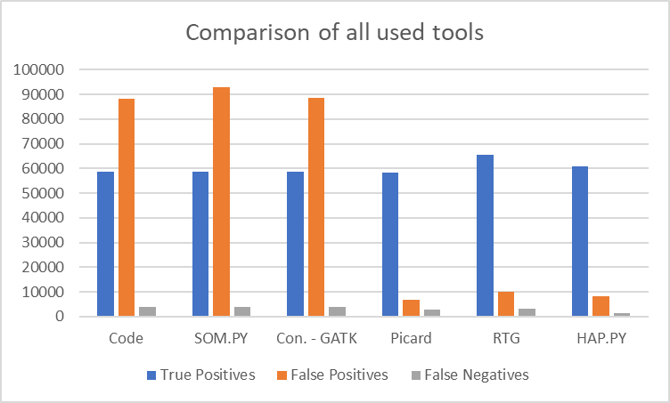
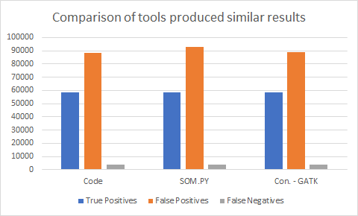
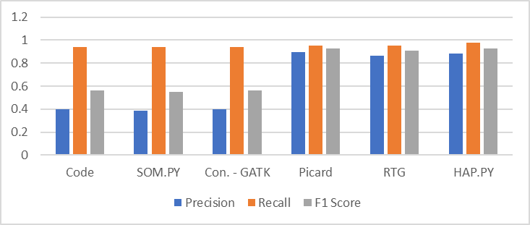
Comparison of metrics calculated by different tools
Picard GenotypeConcordance( from SBG)
TP_COUNT TN_COUNT FP_COUNT FN_COUNT
SNP 58372 28546 6620 2795
INDEL 3722 4851 5033 4163
SOM.PY (comparison of somatic callsets, comparing VCF records)
type total.truth query.truth TP FP FN
indels 7889 9665 0 9665 7889
SNVs 62372 151402 58591 92811 3781
HAP.PY (genotype-level haplotype comparison)
type fileter total.truth TP FN total.query FP
INDEL PASS 7876 6288 1588 8944 2659
SNP PASS 62320 60905 1415 69181 8185
RTG (SBG Variant Comparison)
True-Pos-Called True-Pos-Baseline False-Pos False-Neg
65567 67076 10060 3120
Concordance-GATK
type TP FP FN RECALL PRECISION
SNP 58591 88666 3762 0.94 0.398
INDEL 0 16035 7889 0.0 0.0
Notes:
As we mentioned we used few different tools which were available on CGC – SBGenomics portal as well as which we found online. On this slide we can see results from comparing VCF files using those tools. As we can see on slide some of tools which are based only on VCF records have similar results as our code. (Concordance – GATK and SOM.PY) However other tools like Picard, HAP.PY or RTG which are more advanced and contain some additional operations in order to standardize representation or use different approach when assigning what is TP,FP,FN are having different results. On first graph we can see that number of True Positives are similar for all tools/algorithms we used. Difference is in False Positives. Reason for this is as we mentioned different way in how these tools/algorithms are working. If we take a look at metrics of tools like Picard or RTG we can see that they have much higher precision due to additional level of complexity they have built in their process

Slide 12
Conclusion
Evaluating variant calls requires complex matching algorithms and standardized counting, because the same variant may be represented differently in truth and test call sets.
Sometimes in order to accurately compare VCF files we need to standardize indel representation (left-shifting and trimming the indel alleles), however these methods in other cases could cause errors and more sophisticated comparison methods are required
Since tools are using different approach and they are not all on same level of complexity there is difference in results

Slide 13
Thank you!

